Slide 1

- Ecommerce Website
By
Ankit Jaiswal (191070081)
Tanish Sawant (191070064)
Reshmika Nambiar (191071060)
Prerna Jagesia (191071028)

Slide 2
Aim and Inspiration

Slide 3
Our Objective
The internet is nowadays oversaturated with e-commerce websites full of products made by huge corporations. In such a market, locals making handmade products are overshadowed. Our aim is to bring such products to the attention of potential shoppers via a website.
Bharat ka Sparsh is a website where Indian handcrafted items, traditionally-made clothes, niche local toys, and delicious homemade sweets can be easily sold to shoppers from all over the world.

Slide 4
Bharat ka Sparsh

Slide 5
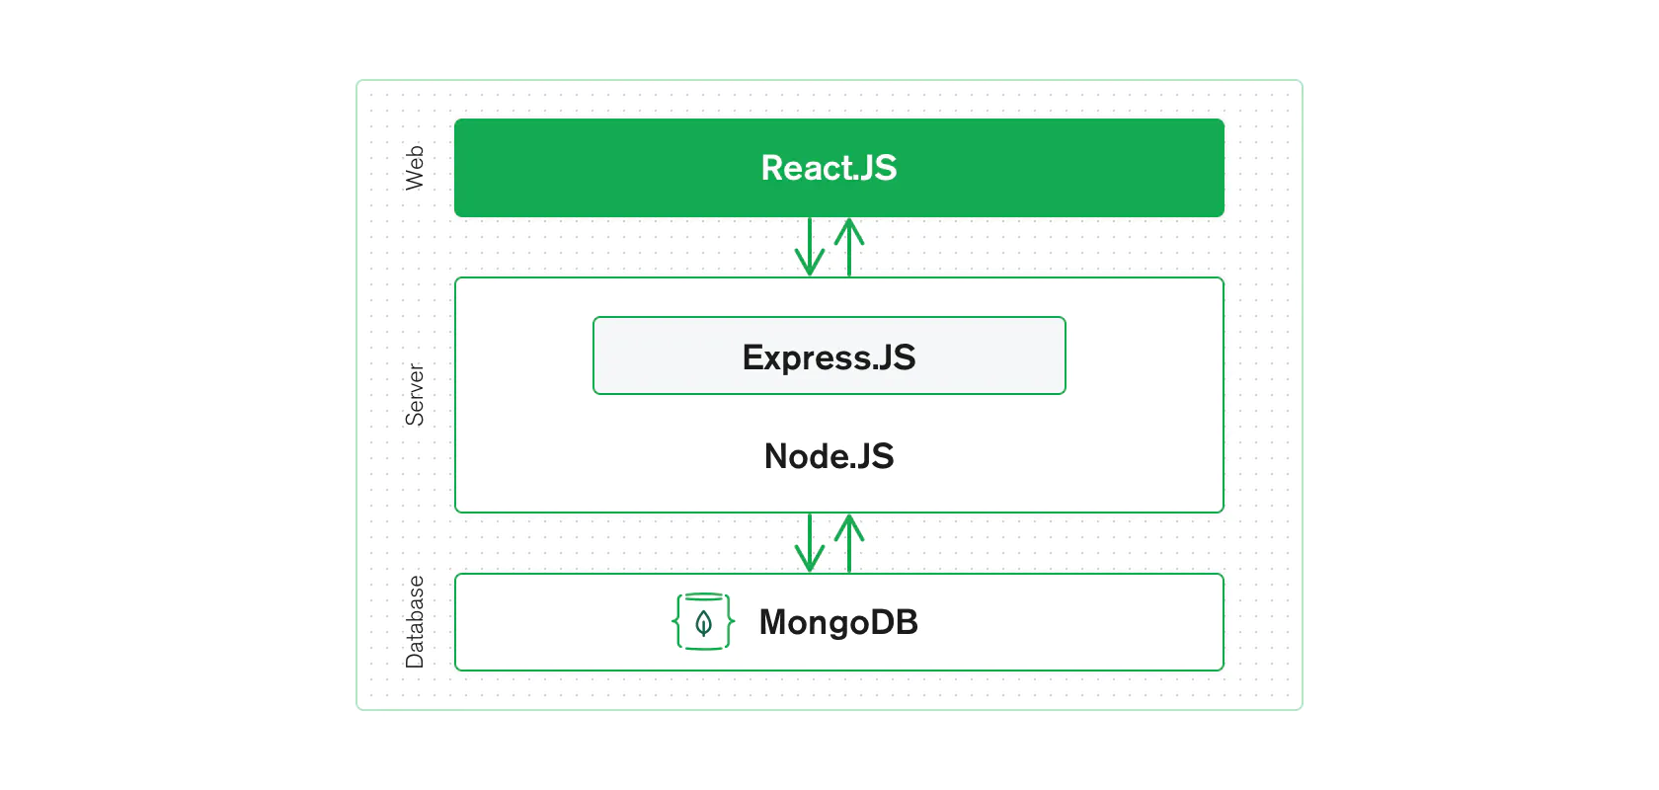
Tech Stack
MERN
MongoDB
ExpressJS
React
NodeJS
All are open source!

Slide 6
Why MongoDB?
Flexible schema - makes it easy to evolve and store data.
Built to scale up quickly.
Supports all the main features of modern databases such as transactions.
Open-source NoSQL database.

Slide 7
Why ExpressJS?
Used for designing and building web applications quickly and easily.
Simplicity, minimalism, flexibility, scalability are some of its characteristics and since it is made in NodeJS itself, it inherited its performance as well.

Slide 8
Why React?
Allows us to create reusable UI components.
Allows developers to create large web applications that can change data, without reloading the page.
Fast, scalable, and simple.

Slide 9
Why NodeJS?
Easily employed as a server-side proxy where it can handle a large amount of simultaneous connections in a non-blocking manner.
Especially useful for proxying different services with different response times, or collecting data from multiple source points.

Slide 10
Why MERN?
MongoDB was designed to store JSON data natively, and everything from its command line interface to its query language (MQL, or MongoDB Query Language) is built on JSON and JavaScript.
MongoDB works extremely well with Node.js, and makes storing, manipulating, and representing JSON data at every tier of your application incredibly easy. For cloud-native applications, MongoDB Atlas makes it even easier, by giving you an auto-scaling MongoDB cluster on the cloud provider of your choice, as easy as a few button clicks.
Express.js (running on Node.js) and React.js make the JavaScript/JSON application MERN full stack, well, full. Express.js is a server-side application framework that wraps HTTP requests and responses, and makes it easy to map URLs to server-side functions. React.js is a frontend JavaScript framework for building interactive user interfaces in HTML, and communicating with a remote server.
The combination means that JSON data flows naturally from front to back, making it fast to build on and reasonably simple to debug. Plus, you only have to know one programming language, and the JSON document structure, to understand the whole system!
MERN is the stack of choice for today’s web developers looking to move quickly, particularly for those with React.js experience.

Slide 11
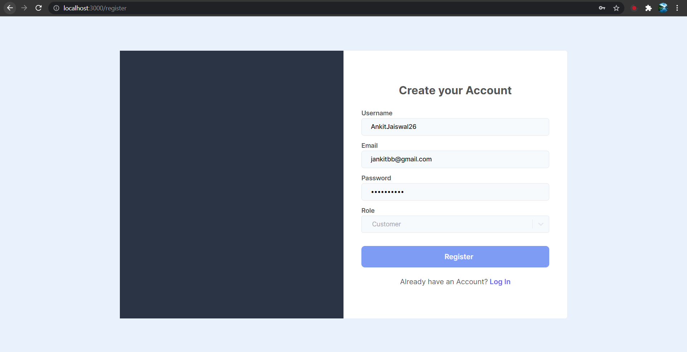
Register

Slide 12
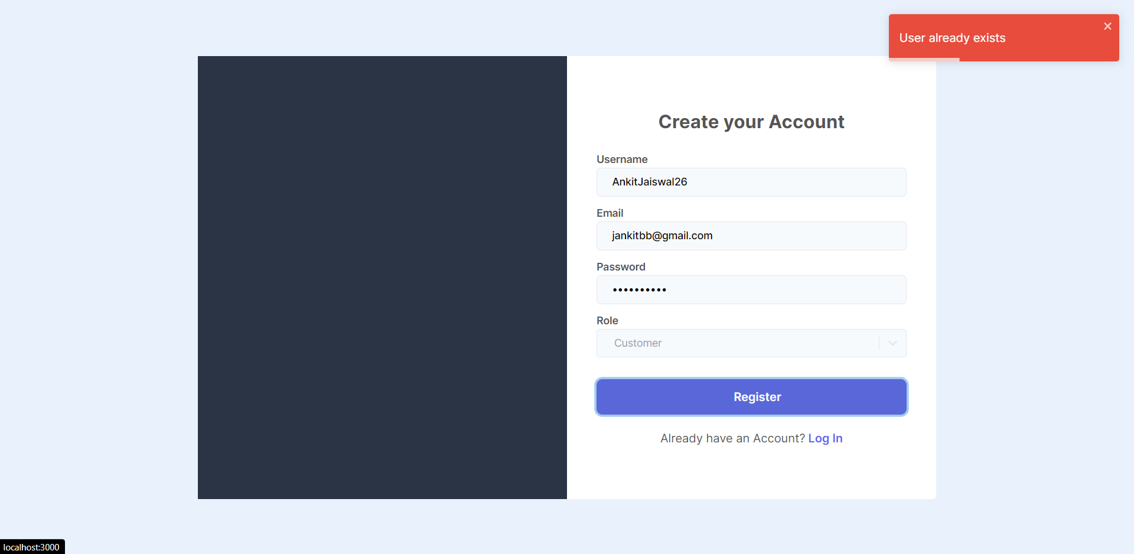
Error message being displayed

Slide 13
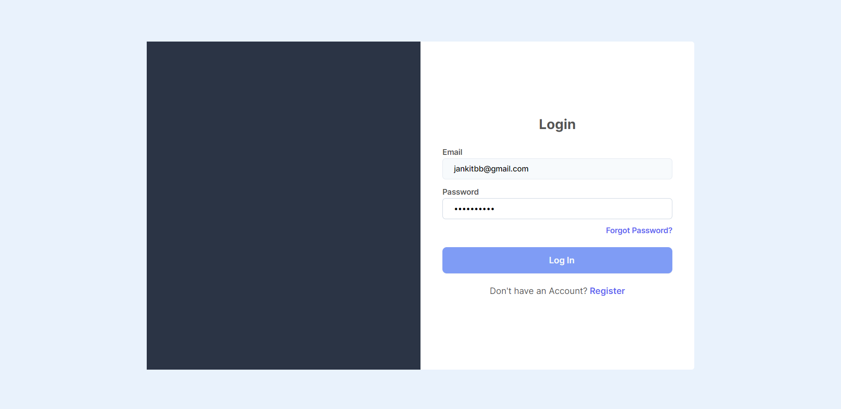
Login Screen

Slide 14
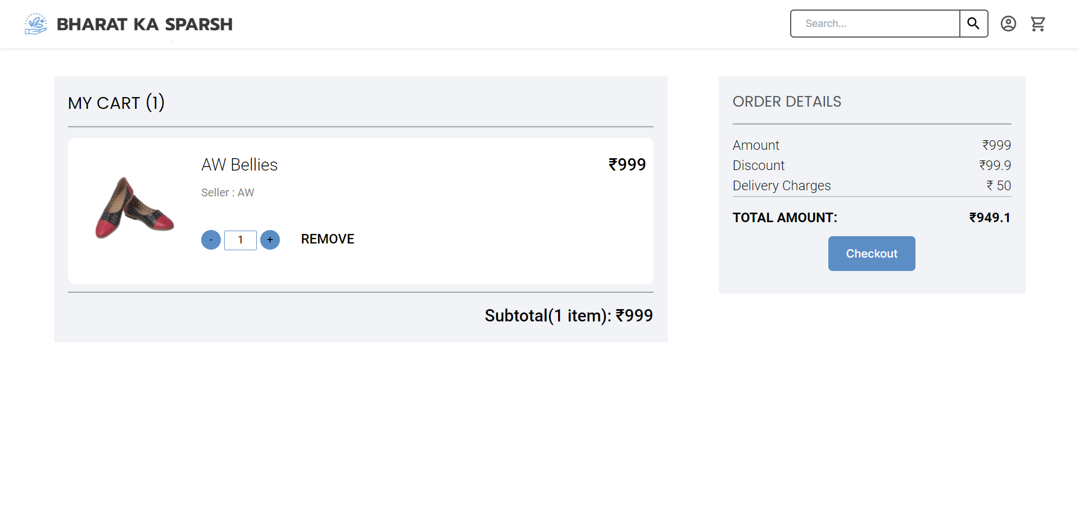
Cart

Slide 15
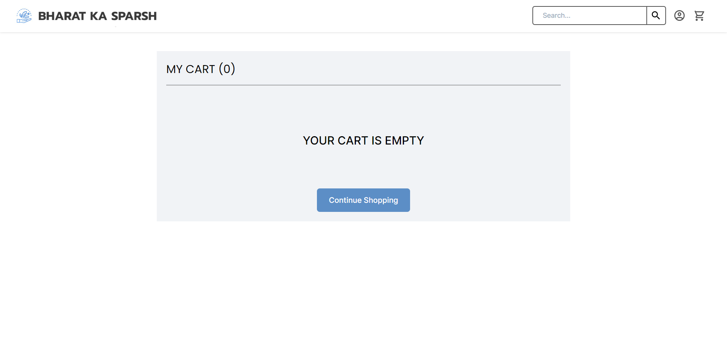
Empty Cart

Slide 16
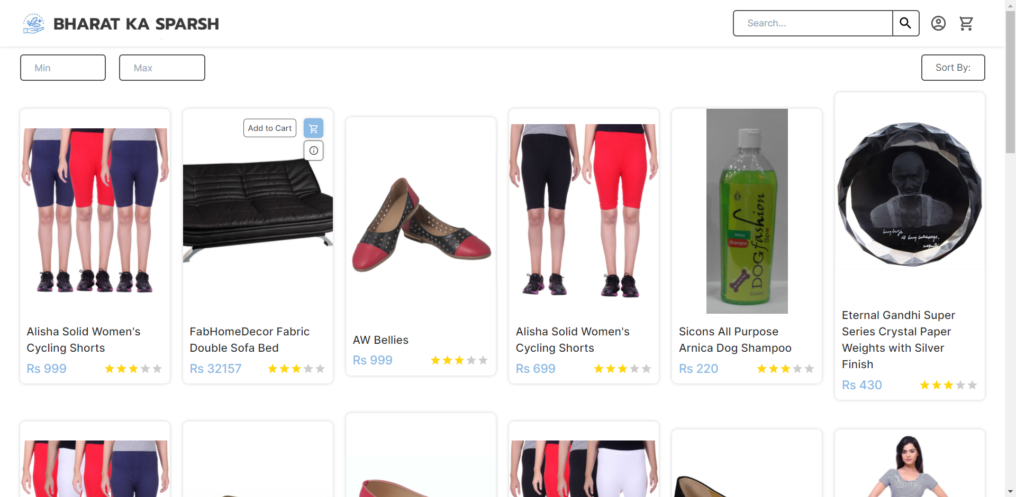
Home Page (Products)

Slide 17
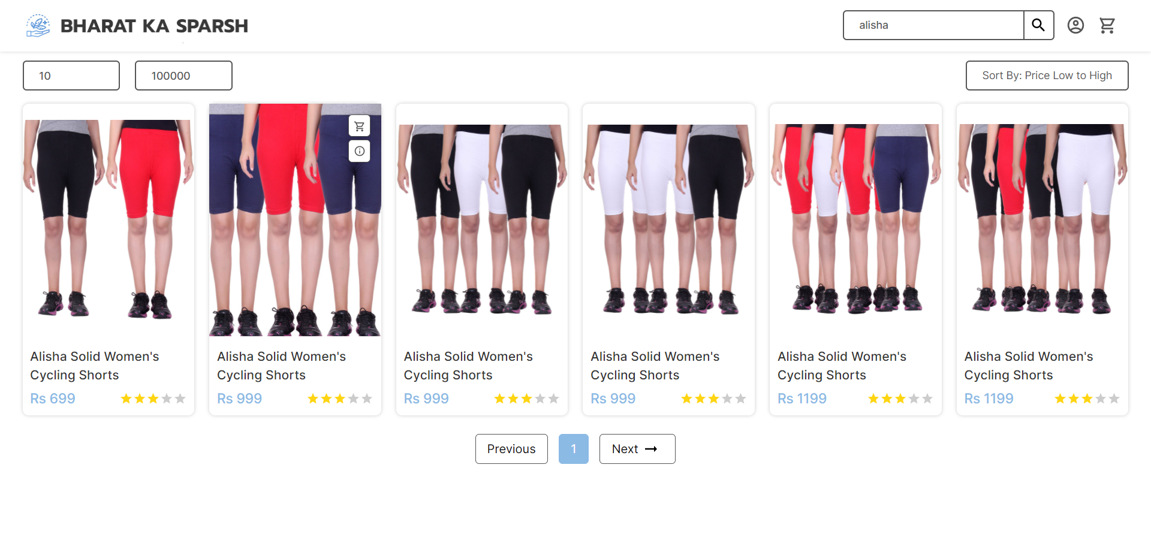
Search and Price filter

Slide 18
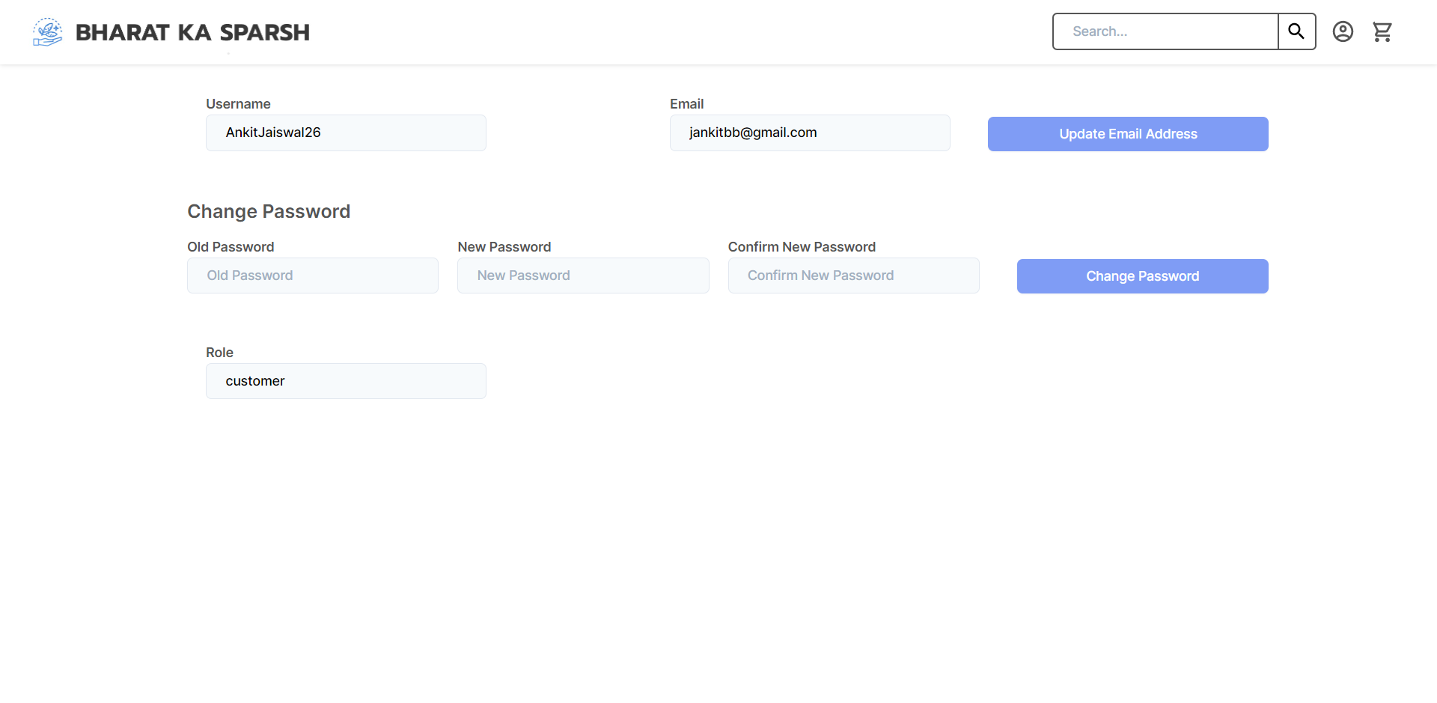
Change profile details

Slide 19
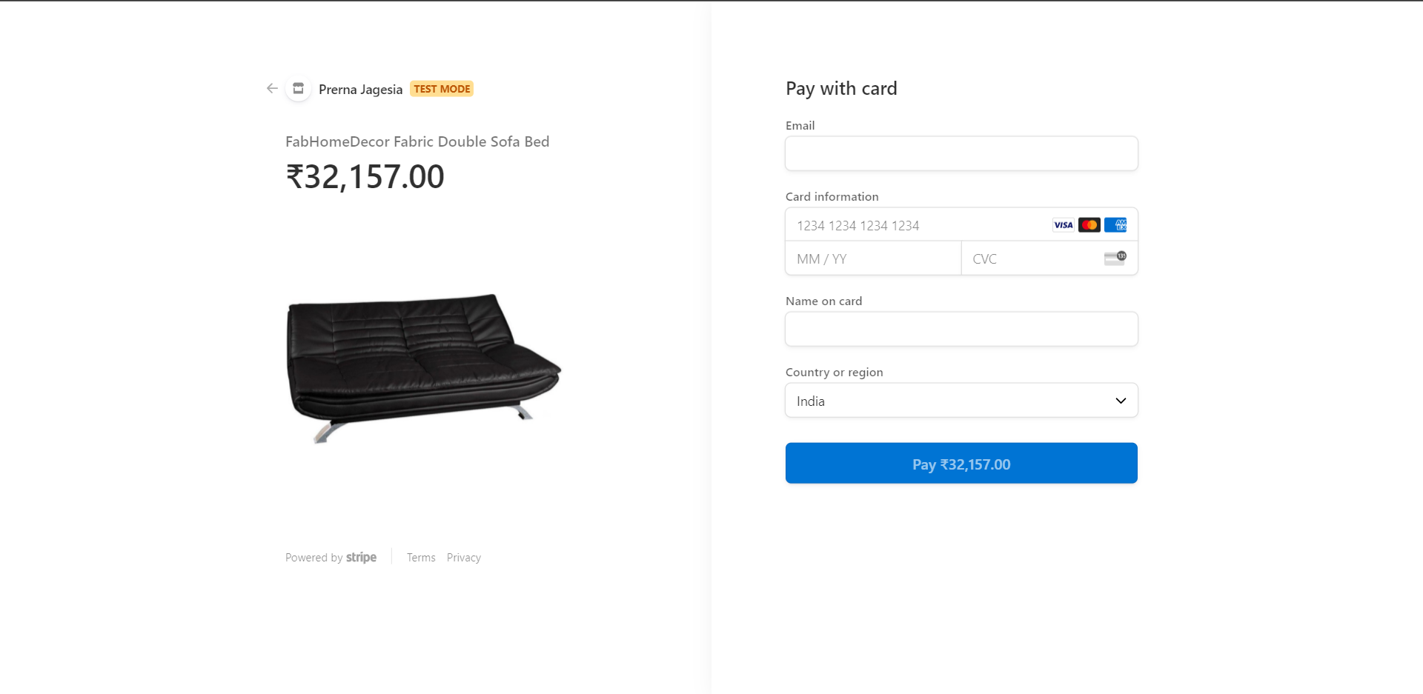
Checkout (Payment)

Slide 20
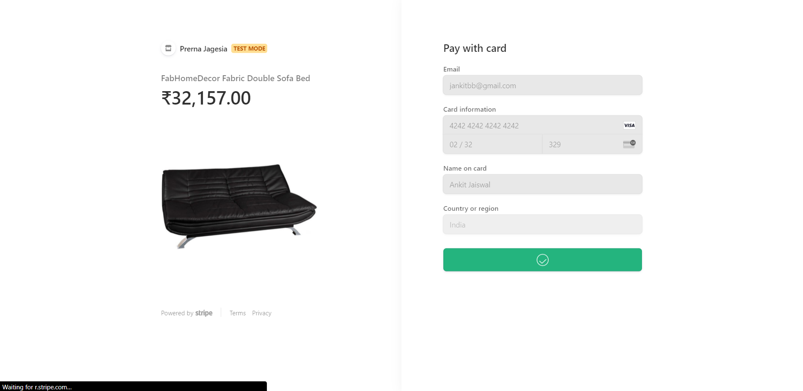
Payment done

Slide 21
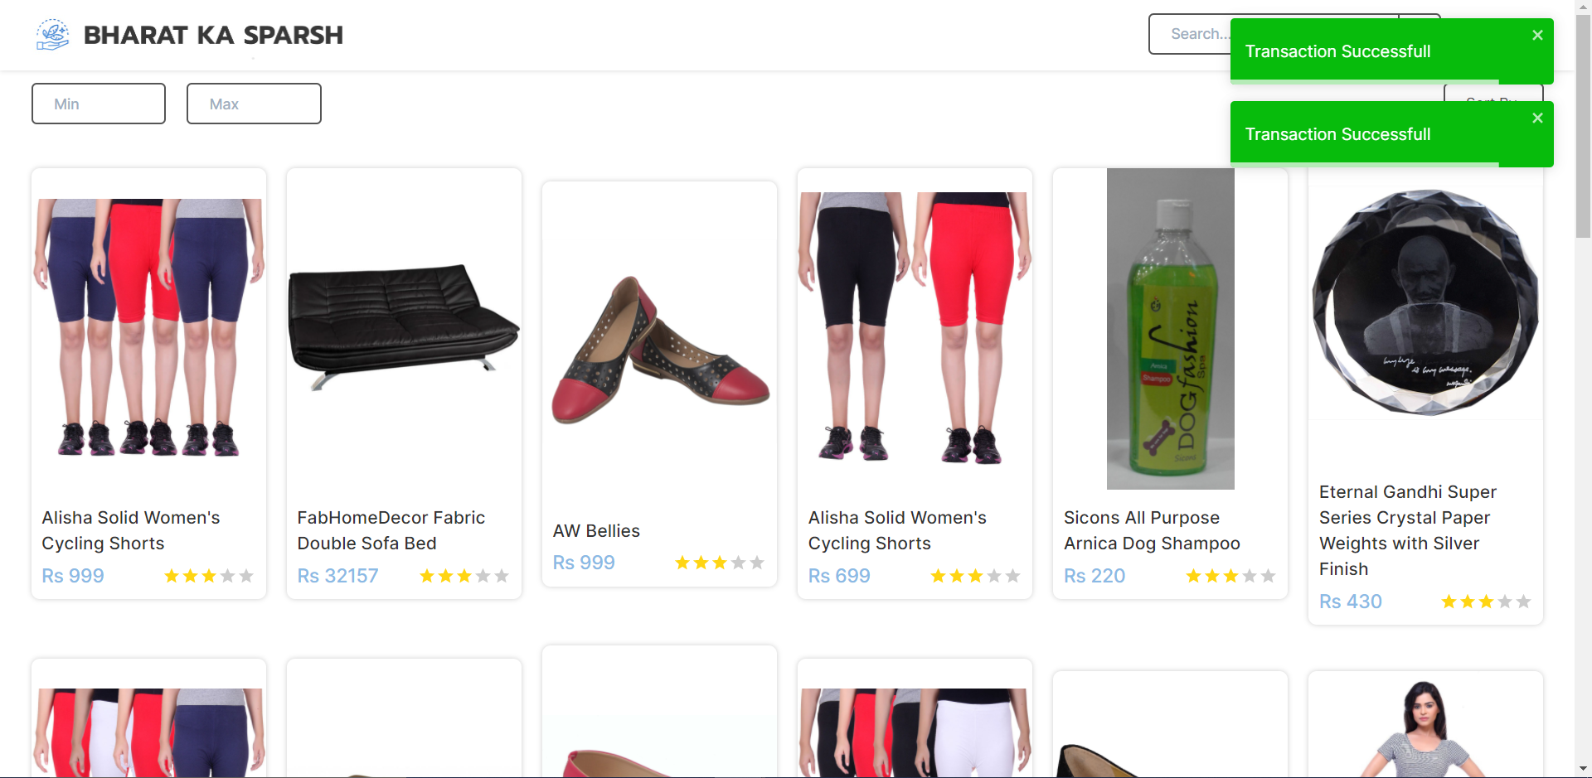
Transaction Successful

Slide 22
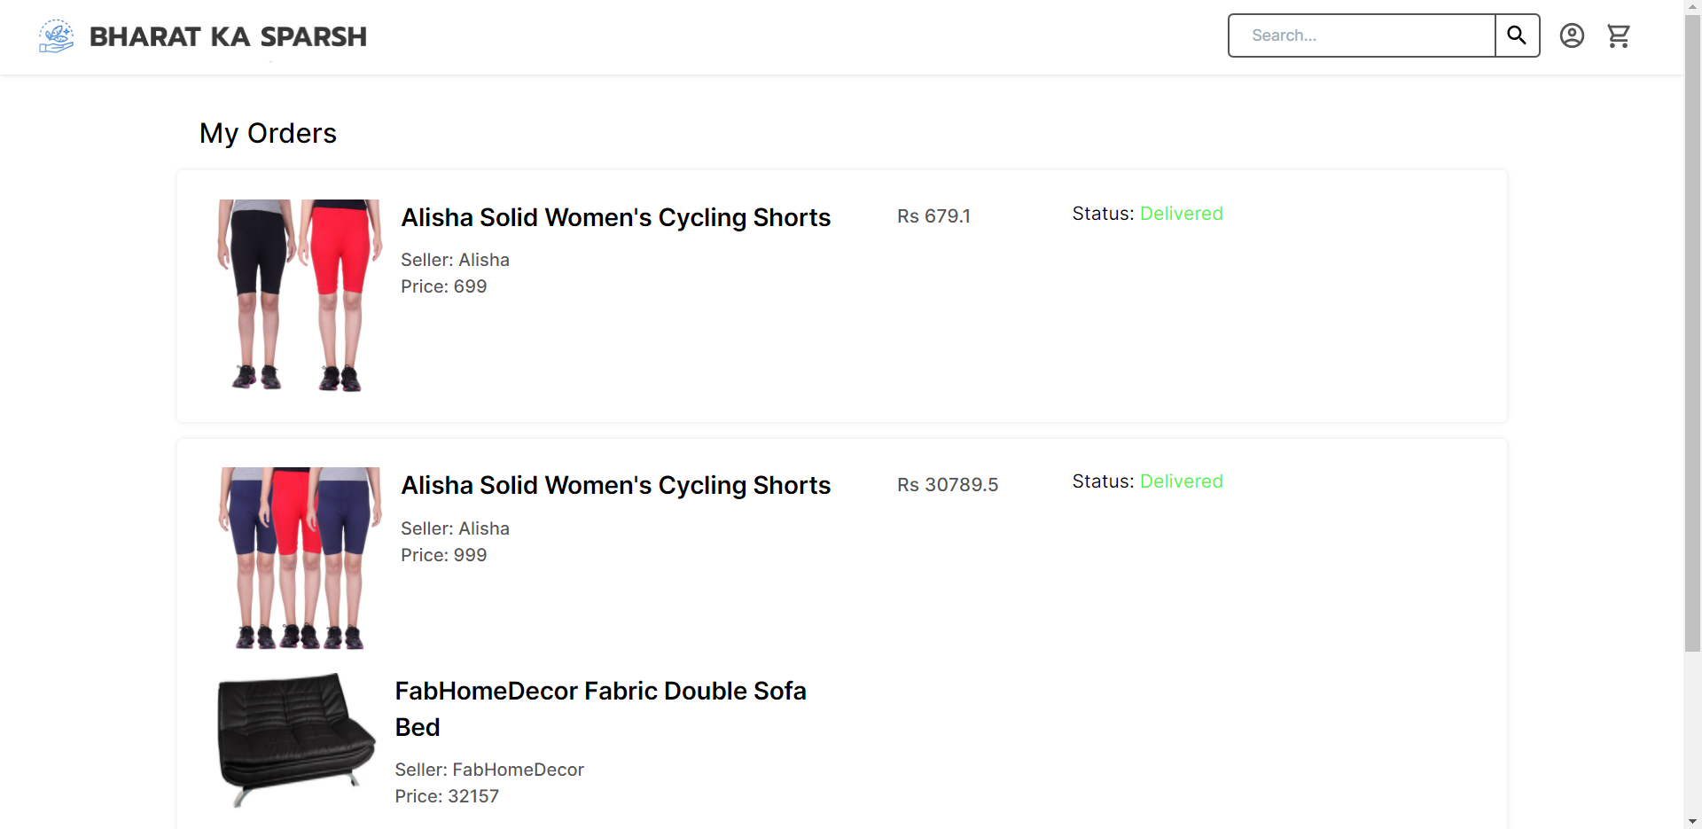
My Orders

Slide 23
Future Scope
Adding User roles (Normal user, Prime user, admin)
Rating System
Customer Feedback and comments
Recommendation system

Slide 24
Conclusion
We have implemented the ECommerce website themed to be used for the trade of homemade products, using MERN stack.

